Slide 1

Communication Technology in Business 2024
Miho Terahata

Slide 2
Conference Schedule
TIME | EVENT | SPEAKER
08:00-09:00 | Registration | Organizer
09:00-09:15 | Opening Remarks | Organizer
09:15-10:15 | Keynote Speech | Dr. Kareem
10:15-10:45 | Coffee Break
10:45-11:45 | Agenda 2 | Dr. Ojima
11:45-13:00 | Lunch | Dining Hall 104
13:00-14:00 | Agenda 3 | Dr. Nam
14:00-14:30 | Coffee Break
14:30-15:30 | Work Shop | Dr. Kareem、Dr. Ojima, Dr. Nam
15:30-16:00 | Closing Remarks | Organizer

Slide 3
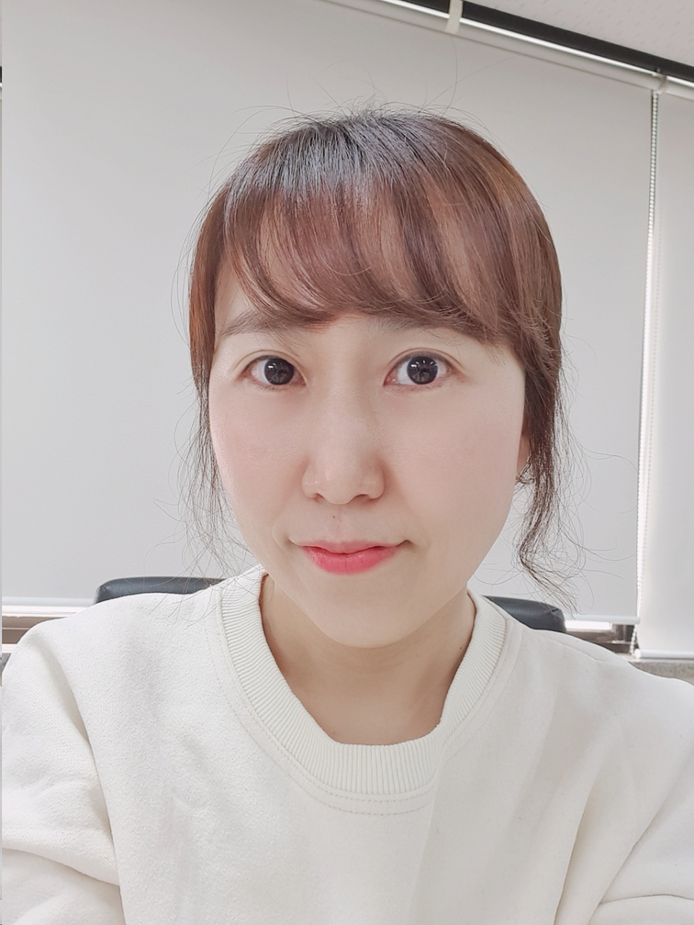
Opening the conference
Dr. Bohyun Choi
Professor of Communication Technology at UBC

Slide 4
Executive Summary
Our group is organizing a conference to enhance communication in the workplace through digital technology. The focus is on effective communication skills, selecting impactful speakers, and audience engagement in the technology era.

Slide 5



Sponsors

Slide 6
Agenda
Dr. Kareem: Maximizing the Advantages of Technology for Improved Employee Communication in Companies
Dr. Ojima: PROBLEM VS. SOLUTION
Overcome problems and change them to chances
Dr. Nam: Unlocking the Future
AI-Driven Customer Communication

Slide 7





Logistics
Target Audience
Ticket Prices
Venue
Capacity
Budget
Employers managers
IT professionals students
Early-Bird $200 General $225 Special Donation $250
East Ballroom A, Vancouver Convention Centre
Approx. 300 guests
Approx. $42,000

Slide 8
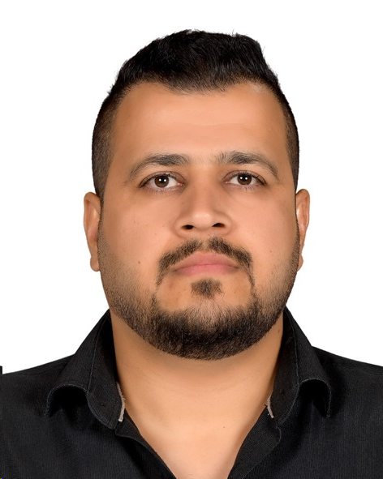
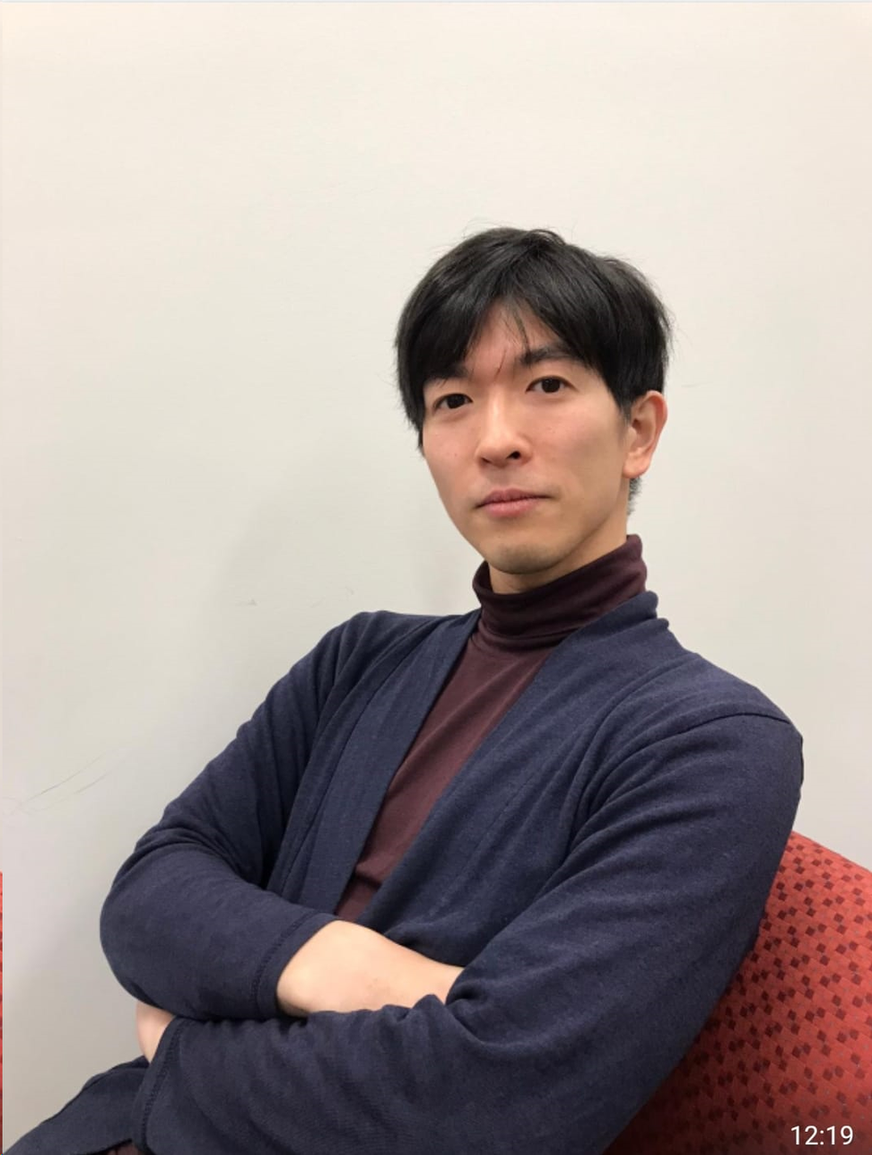
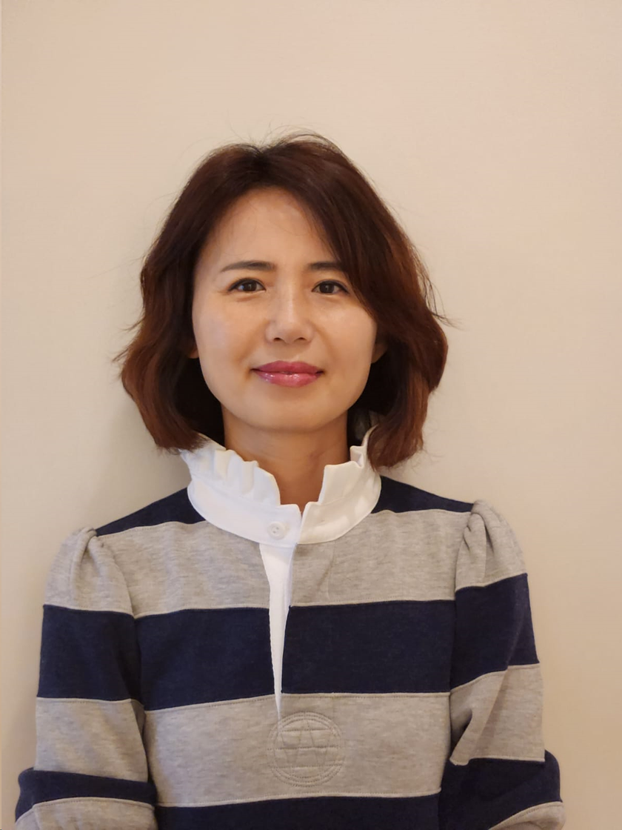
Guest Speakers
Dr. Seerwan Kareem
Dr. Yasunori Ojima
Dr. Joohee Nam
Executive Communication Officer of
TELUS Corporation
Former Amazon Digital Strategist
Current Microsoft Specialist
Generational Expert
Media Entrepreneur

Slide 9
Dr. Seerwan Kareem
Executive Communication Officer of
TELUS Corporation

Slide 10
Maximizing the Advantages of Technology for Improved Employee Communication in Companies
Dr. Seerwan Kareem

Slide 11
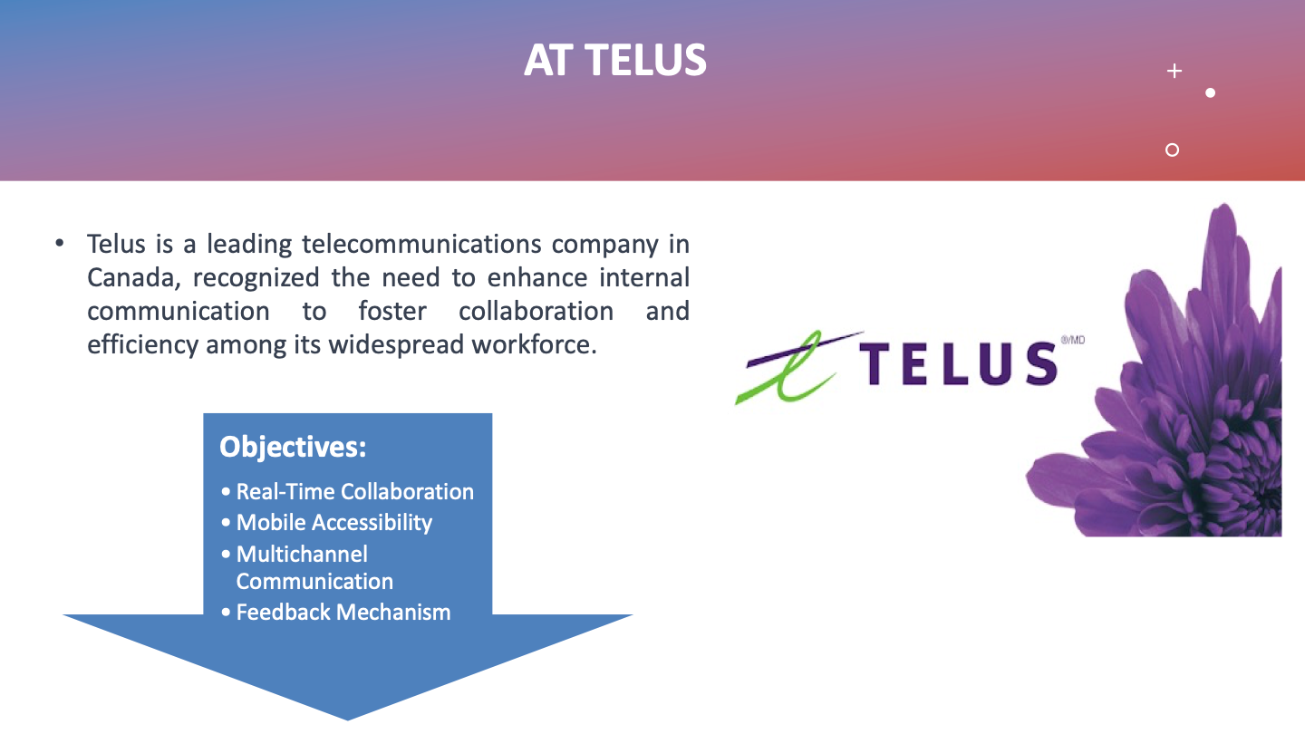

Slide 12
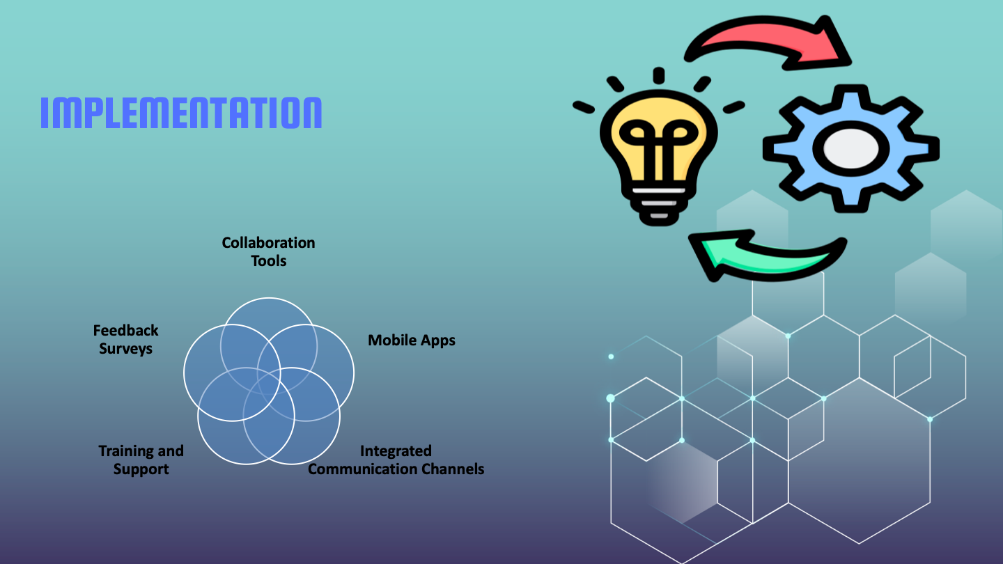

Slide 13
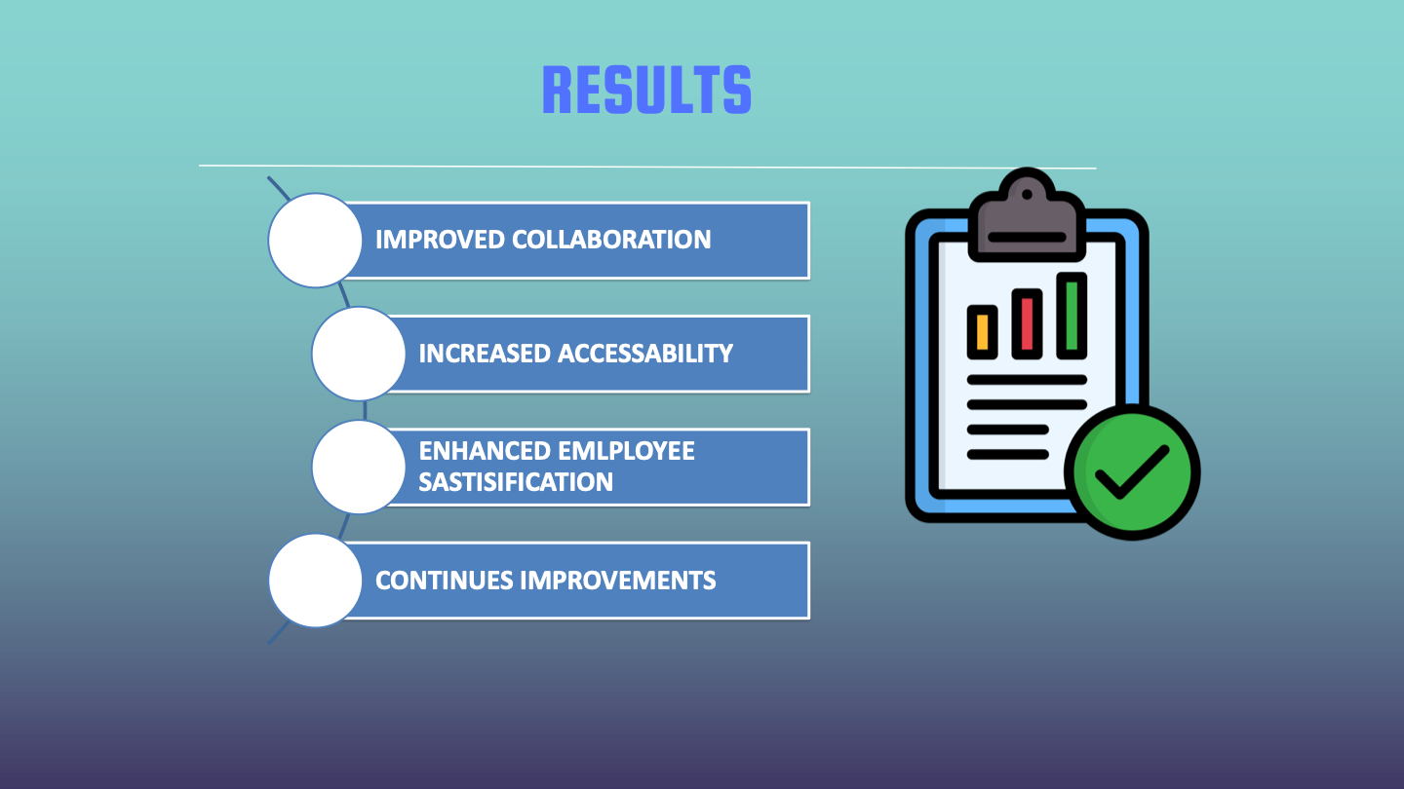

Slide 14

BREAK

Slide 15
Dr. Yasunori Ojima
Former Amazon Digital Strategist
Current Microsoft Specialist

Slide 16
PROBLEM VS. SOLUTION: Overcome problems and change them to chances
Dr. Yasunori Ojima

Slide 17

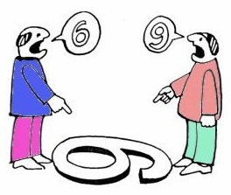

Problems happening in workplaces
・Increasing Miscommunication
- misunderstanding, unintended interpretation
・Technology Risks
- information leakage, invasion of privacy
・Feeling of Social Isolation
・Uncertain/Fake information
・Digital Divide

Slide 18
Causes of the problems
3Ls
・Loss of non-verbal communication
・Lack of internet literacy and vulnerability
・Less communication

Slide 19
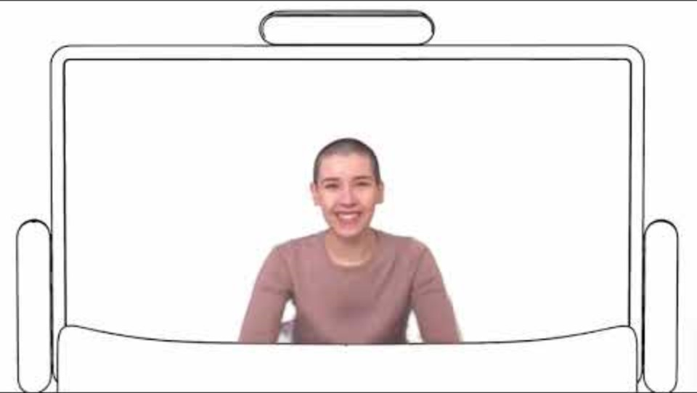
Overcoming and Chance
The key is brand-new breakthrough 3D innovation

Slide 20

Overcoming and Chance
The key is brand-new breakthrough 3D innovation
REAL COMMUNICATION
・All technologies have limits especially when they are new
・Real communication and
the one via technologies
are irreplaceable each other

Slide 21

LUNCH

Slide 22
Dr. Joohee Nam
Generational Expert
Media Entrepreneur

Slide 23

Unlocking the Future: AI-Driven Customer Communication
Dr. Joohee Nam

Slide 24
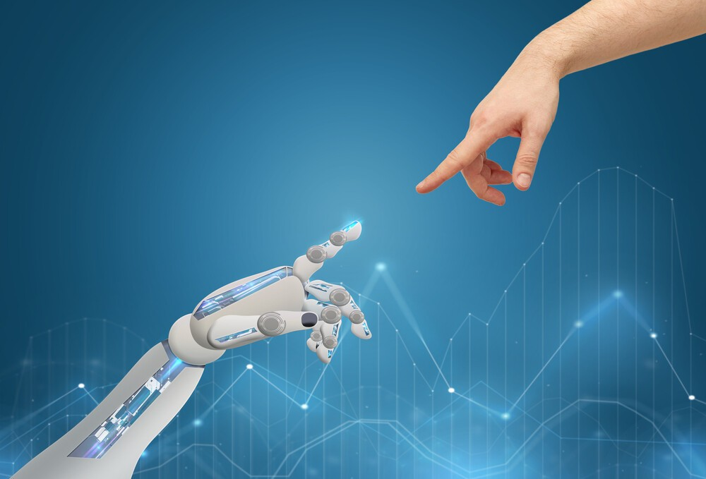
Emotional Intelligence in AI
Sentiment analysis and emotional recognition allow AI systems to understand and respond to human emotions.
Open up new possibilities for AI to serve as empathetic and supportive entities.

Slide 25
Integration of AI into customer communication
Transparent secure respectful of user privacy

Slide 26
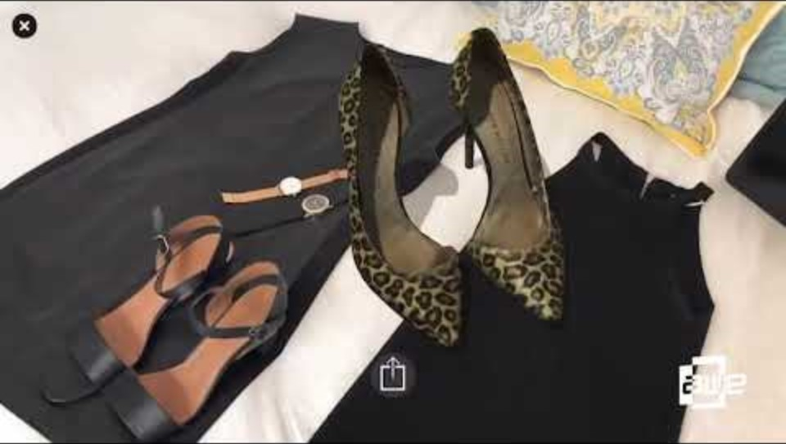

Slide 27
Closing the conference
Workshop: Dr.Kareem, Dr.Ojima, Dr.Nam
Prize Drawing-# on the Brochure
Survey-Exchange with a souvenir

Slide 28



Thank you

